Slide 1
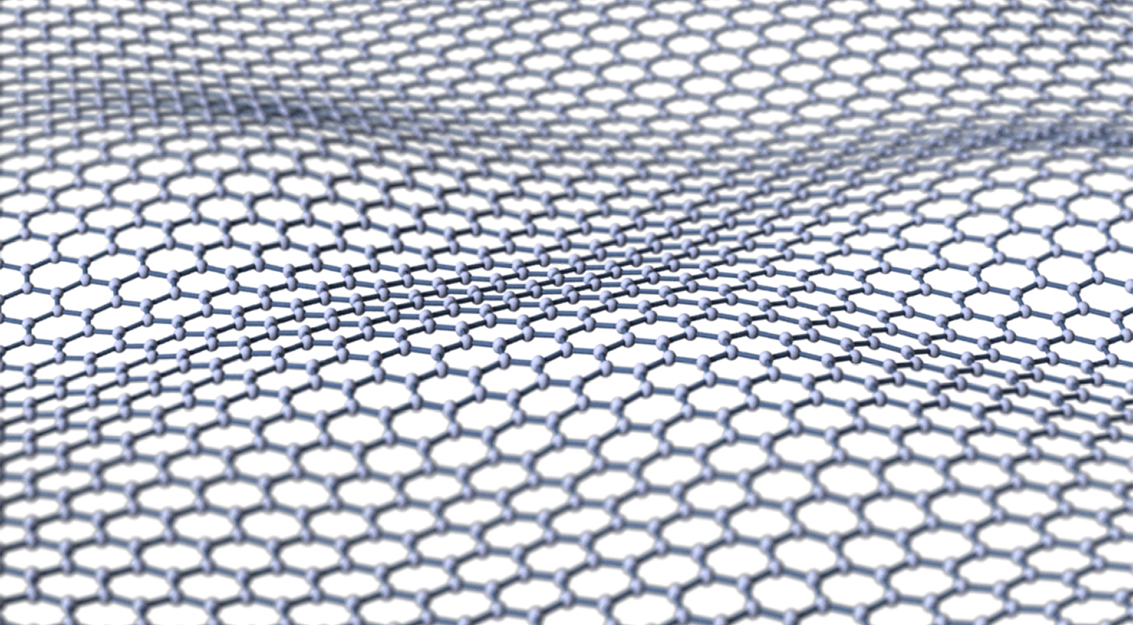
Emerging Technology: Graphene
By: Darian Woehr

Slide 2
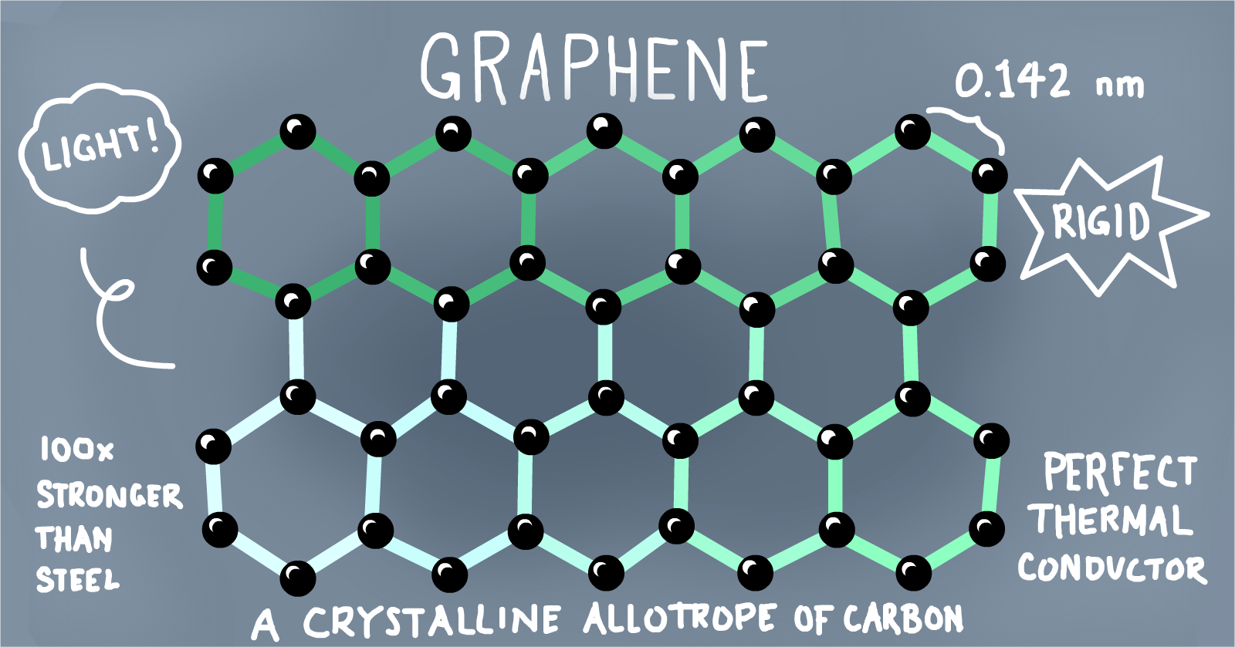
What is Graphene?
https://www.youtube.com/watch?v=0fbQX5VJmew

Slide 3
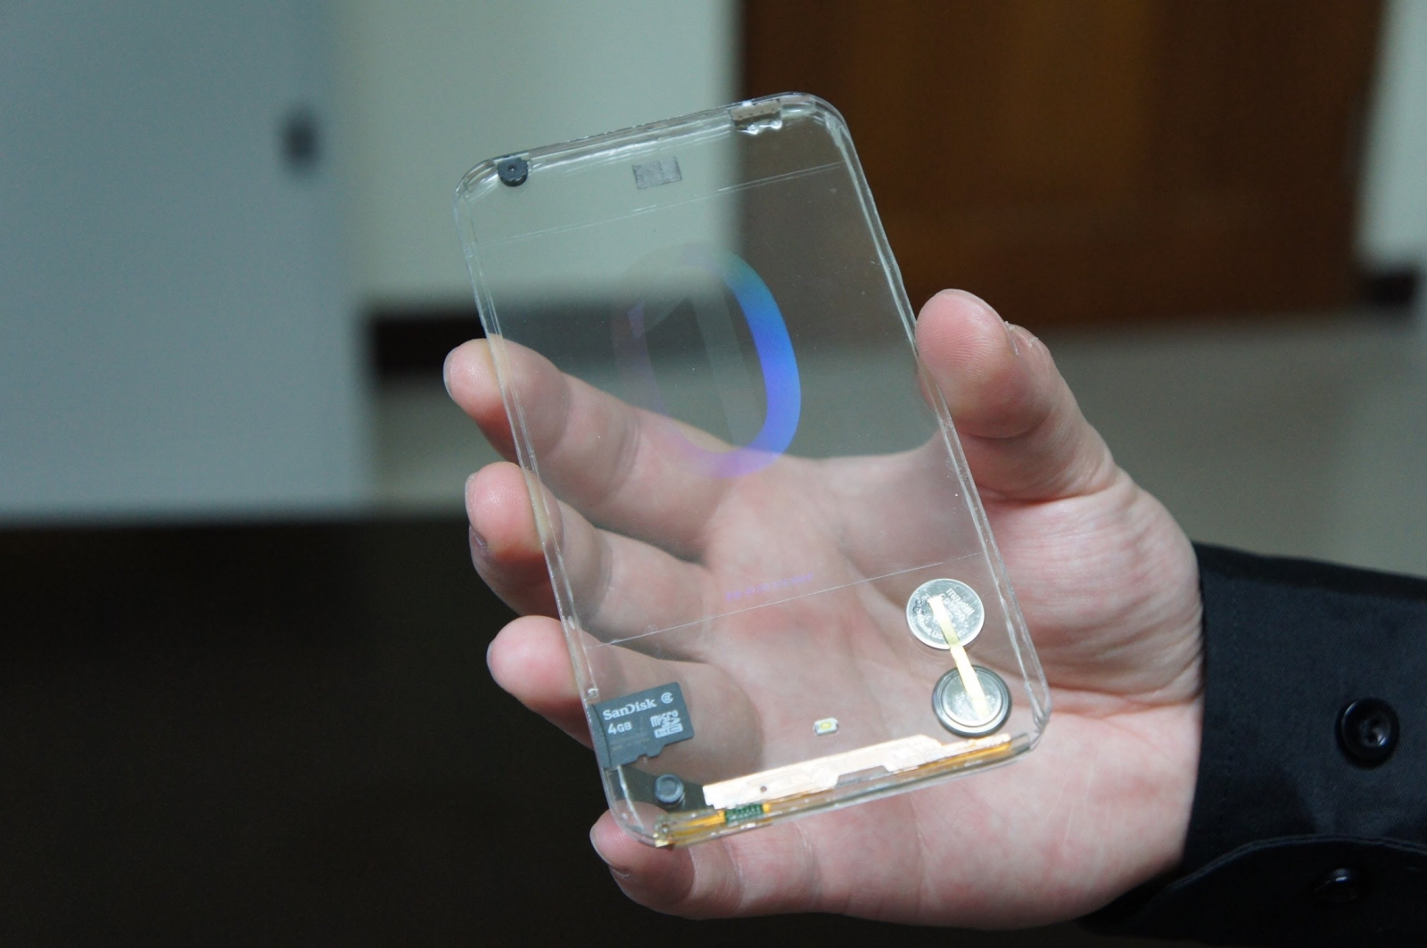
What is the future of Graphene?
Replace silicon as a semiconductor in electronics
Serve as a microchip that is 300x faster than chips available today (smaller and more powerful)
Revolutionize data transfer by creating smaller optical modulators than transfer data up to 10x faster
Batteries with longer lives and more power

Slide 4
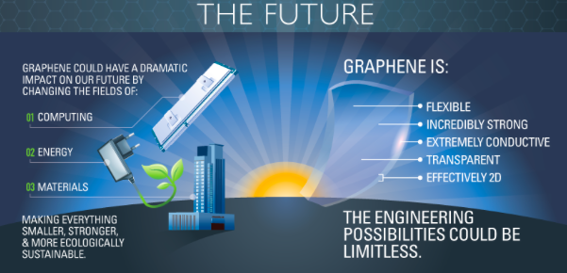

Slide 5
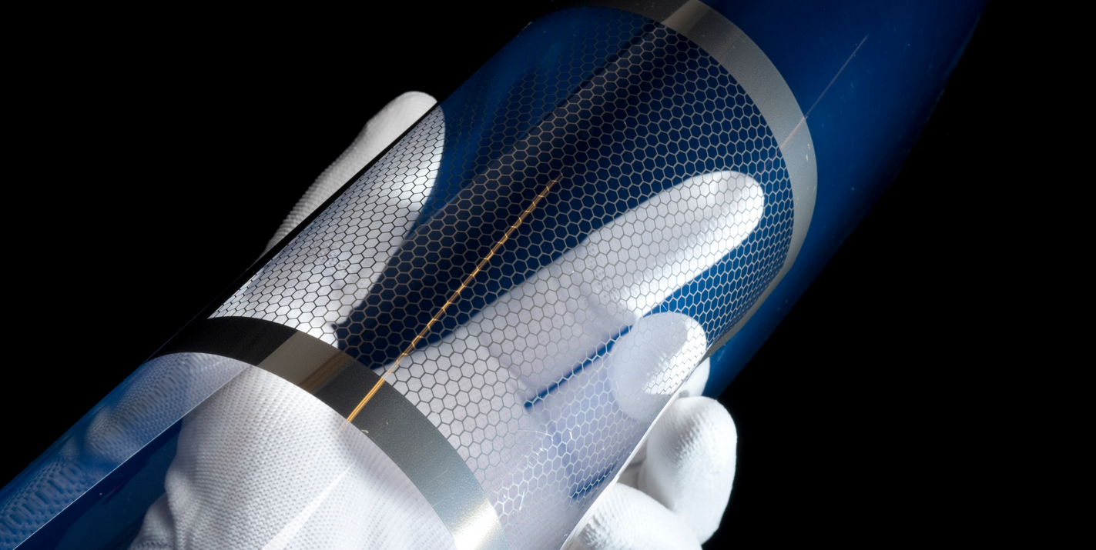
How can Graphene aid in storytelling?
Easier, quicker transmission of data
Smaller and more powerful chips and batteries for computers, phones, cameras allowing for more durable and portable technology
This will allow for more ease in recording and sharing information/stories

Slide 6
Sources:
http://www.strategyr.com/MarketResearch/Graphene_Market_Trends.asp
https://cloudtweaks.com/2014/09/cloud-infographic-graphene-internet-things/
http://www.compoundchem.com/2015/06/23/graphene/

Slide 7
Questions?

